Slide 1
OHCHR
NON-DISCRIMINATION, RACISM AND SPORT

Slide 2
WHAT WE WANT TO ACHIEVE
Influence policy making
Carry a powerful human rights message directly to the people and to involve them actively in spreading the message

Slide 3
WHY WE NEED TO ENGAGE
To promote human rights, we need to reach people.
Sport offers OHCHR a unique opportunity to transcend the confines of “diplomatic Geneva” in order to reach millions of fans.
Sport is a school for life – for athletes and spectators.

Slide 4
THE WORLD WATCHES
2014 FIFA World Cup: 3.2 billion viewers, one billion watched the final.
2015 Cricket World Cup match between India and Pakistan: 1 billion viewers.
2018 FIFA World Cup Russia - move towards streaming.

Slide 5

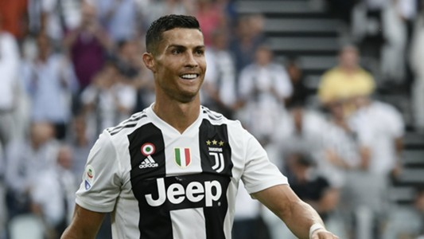
GROWING BUSINESS
2016 – 2019
3 Years 504 games £ 5,13 billion
£ 10,19 million a game
(ca. €11,2 million)
Ronaldo
47 million Twitter followers (Tweets are worth £169,000)
109.7 million fans on Facebook
49.6 million on Instagram (Instagram post £308,000)

Slide 6
OHCHR AND SPORT & NON-DISCRMINATION
Past years increasing attention by OHCHR.
HRC, IGWG and Ad Hoc have realized and emphasised the magnitude and potential of sport.
Selected ARDS Projects:
    FIFA Task Force (finalised)
    All Equal Football Cup (2015)
    Side Event on Sport and Human Rights (June 2016)
    Side Event on Sport and Migrants, Refugees (October 2016)
    HRC Social Forum (2018)

Slide 7
2018 FIFA WC IN RUSSIA
To include non-discrimination policies - preparation of the FIFA World Cup 2018 in Russia – and beyond (Legacy).
  2015 Stakeholder Meeting Moscow
  2015 Human Rights Commissioners, St. Petersburg
  2016 Roundtable and fan workshop, Vladimir/Kovrov
  2017 Cooperation with Human Rights Commissioners initiated
  2017 Cooperation with UNESCO/Moscow applies for ECCAR membership
  2017 The «LEGACY» project starts
  2018 Workshops with Human Rights Commissioners etc.
  2018 Finalisation 2018 FIFA World Cup Russia Non-Discrimination Legacy by the end of the year
  Pilotproject
  Role model for further engagement (e.g. Qatar)

Slide 8
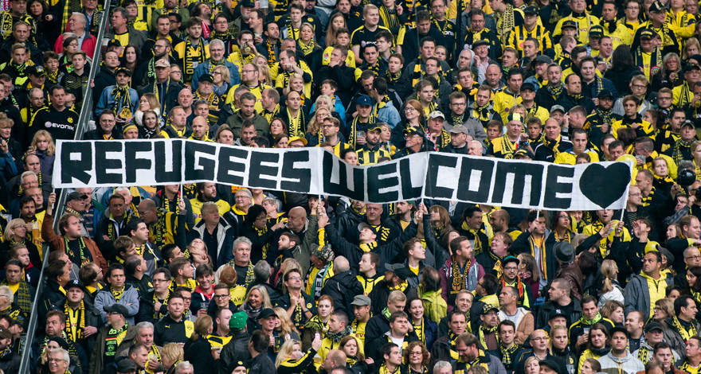
RACIAL DISCRIMINATION
Most sport federations have rules BUT…
Lack of nation-wide “guiding principles”.
(Measures that non-discrimination policies should consider, such as) …
  Pursuance of a multi-stakeholder approach;
  The adoption and enforcement of national action plans and strategies against discrimination in sport;
  The encouragement of diversity in sports;
  Considering the intersection of discrimination;
  Targeted sanctions against individual perpetrators;
  Long-term prevention strategies that focus on dialogue and empowerment.

Slide 9

THE WAY FORWARD
To Do
Strategy and internal structure
ENVISIONED ENGAGEMENT
Substantive Engagement
Policy Formulation
Convening Power
International best practices
Diversify (e.g. Rugby etc)
Advocacy, Networking and Outreach

