Slide 1

Fare Observer System
Tackling Discrimination at International Matches
Pavel Klymenko,
UN IGWG on the effective implementation of the Durban Declaration and Programme of Action
27 August – 7 September, Geneva

Slide 2
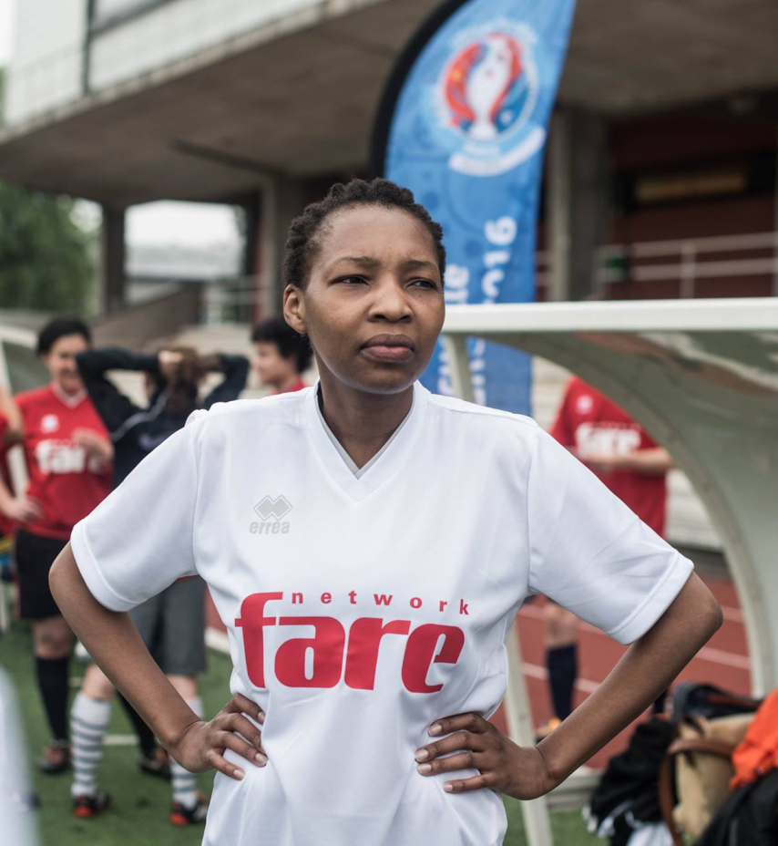
Fare network
Active in 40+ countries
Membership – NGOs, minority groups, fan groups
Fighting discrimination in football and through football
#FootballPeople Action Weeks biggest activity (1000+ events globally)

Slide 3

Football: Two sides of the coin
Universal language for millions worldwide
Global game reflecting diversity on the pitch
Reproducing and reinforcing patterns of discrimination
Mirroring discrimination against minorities
Has the power to unite and celebrate diversity

Slide 4
Fare Observer system
Launched at UEFA competitions in 2013
Global system on all continents for the FIFA World Cup 2018
Trained observers recording discrimination at 200+ matches
Sanctions for discriminatory conduct by FIFA
National-level debates about discrimination
The need for a stronger framework and response by regulators

Slide 5
How does it work
Assessment of matches to identify risk levels
Trained observers sent to high-risk matches
Recording evidence of discrimination
Reporting to football governing bodies

Slide 6
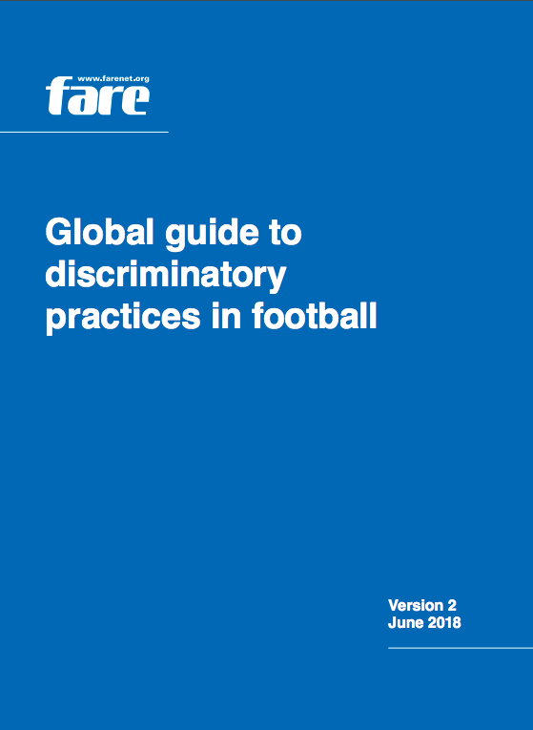
Global Guide to Discriminatory Practices
Created for the FIFA World Cup 2018
Discriminatory practices used in football on all continents
Mirroring discrimination in society against people of African descent, Roma, women, LGBT+ people
Recognise and prevent the display of symbols and behaviour

Slide 7
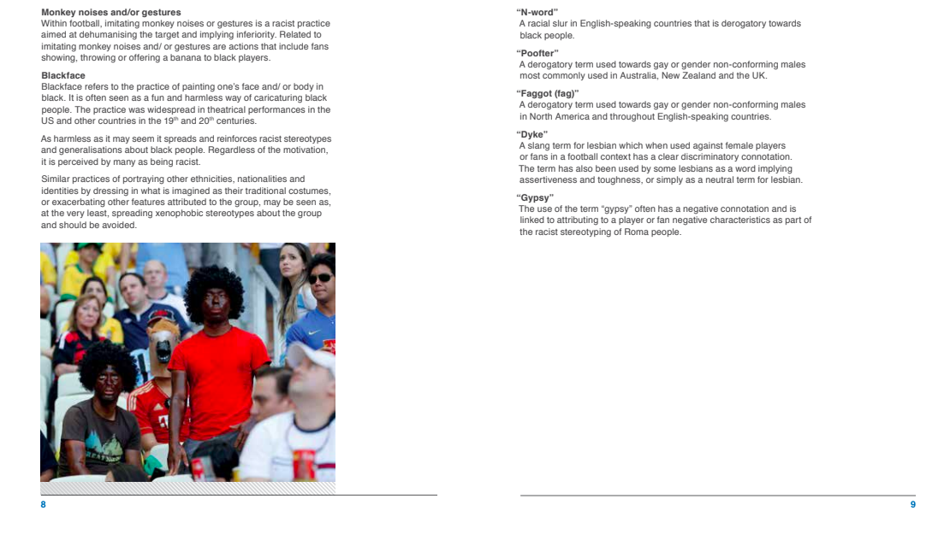

Slide 8
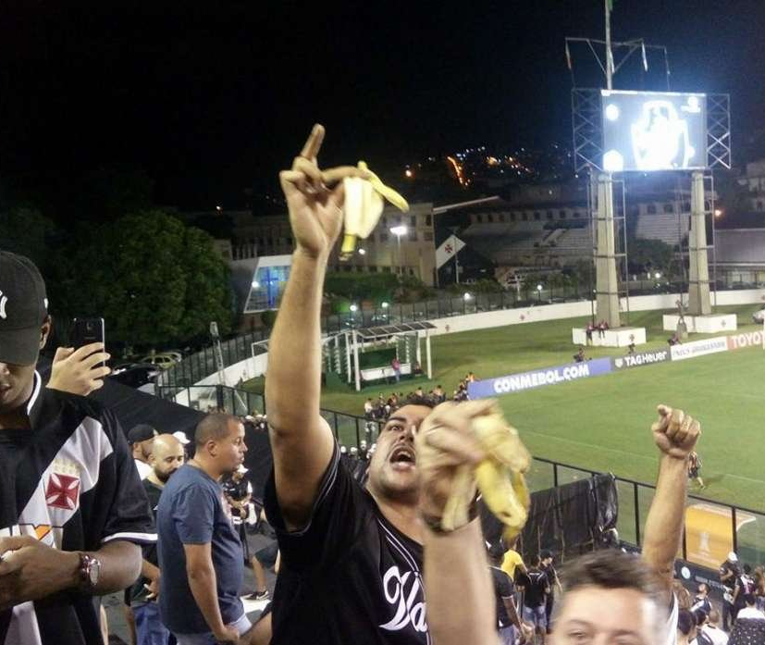
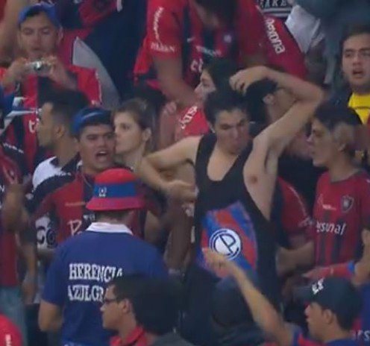
Discriminatory practices
Racist chanting, monkey gestures
Sexism
Homophobia
Islamophobia
Anti-Semitism

Slide 9

Impact
Change of behaviour at international competitions
Far-right groups refrain from activity inside stadiums
National level debates after sanctions
Advising football governing bodies and clubs

Slide 10
Using sporting mega events to promote diversity
FIFA World Cup 2018: Fare Diversity House
The only human rights intervention at the tournament
Safe space for minorities and NGOs
Events on human rights with local organisations
Diversity Guide to Russia

Slide 11


