Slide 1
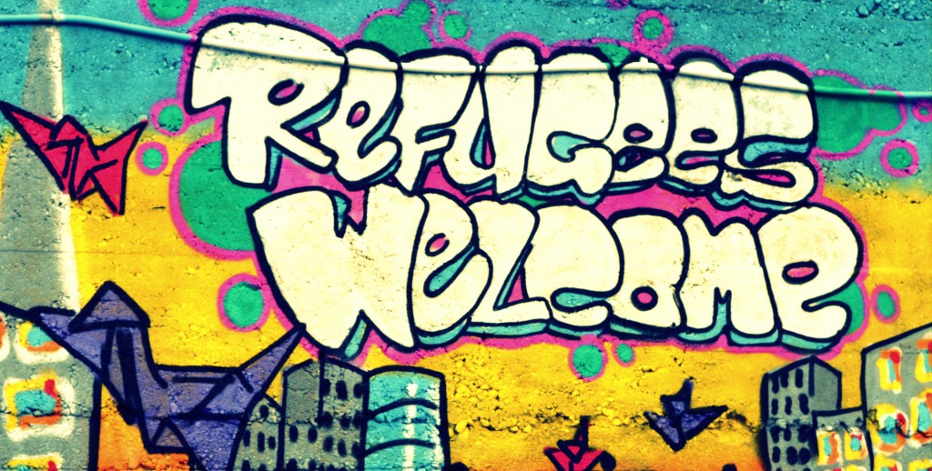
Attitudes towards migrants and refugees:
What are they and how can we change them?
Heaven Crawley, Coventry University

Slide 2
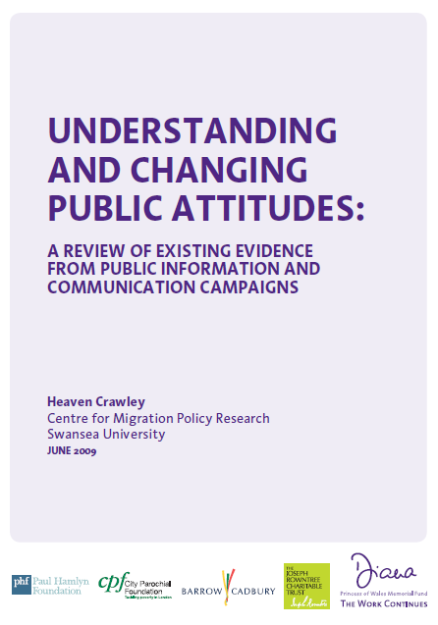
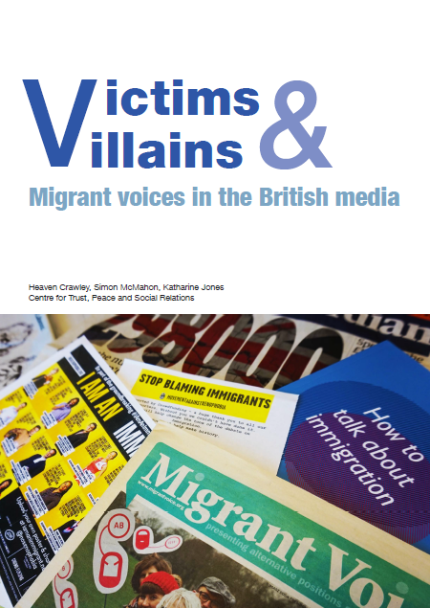
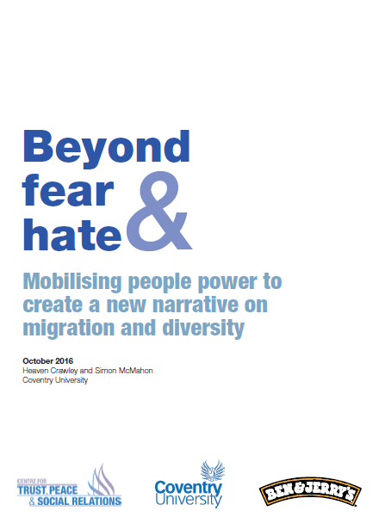

Slide 3
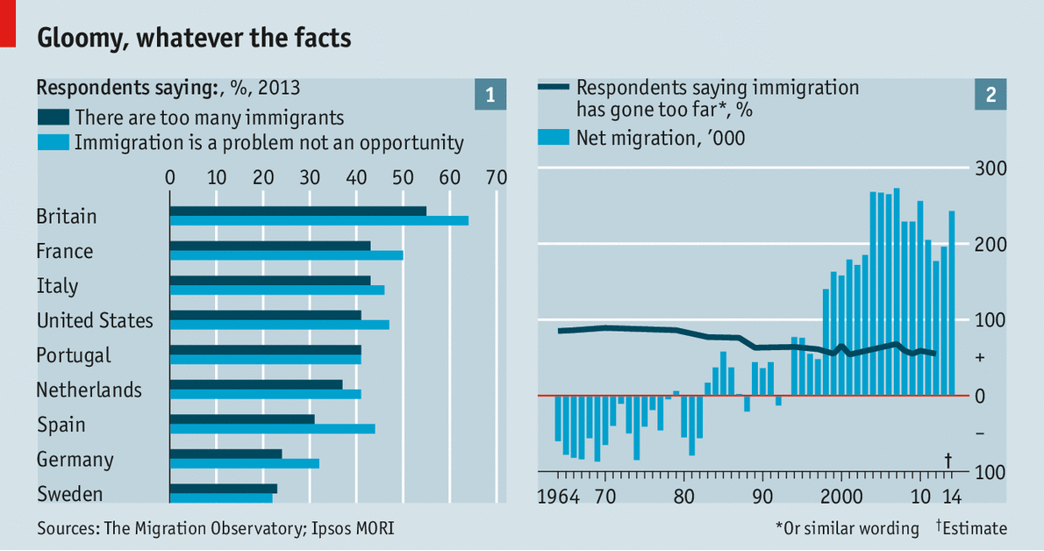
What people think about migration

Slide 4
“Whilst it may appear that attitudes are firmly against migration and diversity, in reality there is a polarisation of views with an almost equal split between those (a quarter of the population) who see migration as a threat and those who believe that it brings economic, social and cultural benefits.”

Slide 5
Factors shaping attitudes
The ‘crisis’ is not migration itself but our response to it
Socio-economic and demographic characteristics of different communities
Role of print, broadcast and social media
Lack of meaningful social contact
The economic and social consequences of increased migration and diversity
The (mis)use of migration to leverage political support and distract from political failures

Slide 6
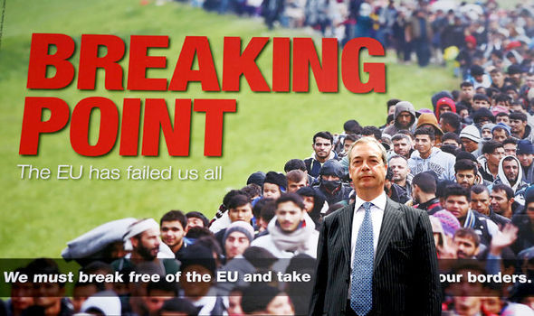

Slide 7
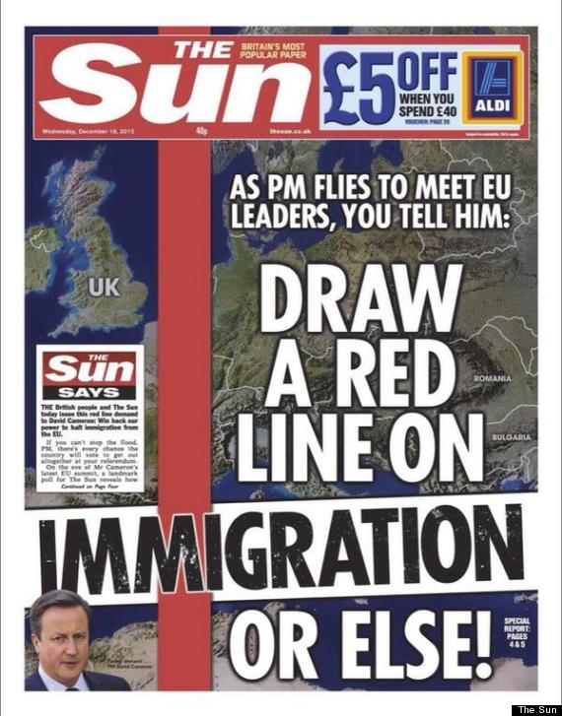
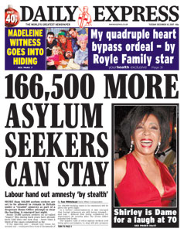
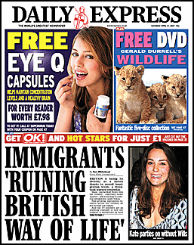
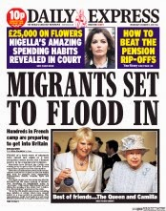
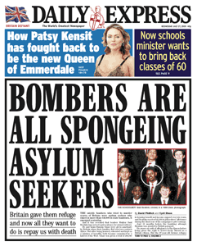
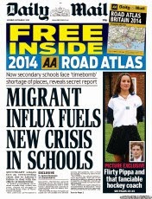
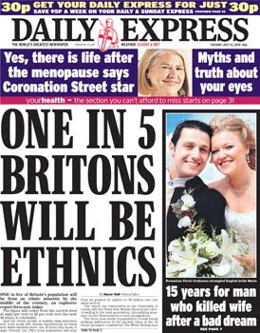
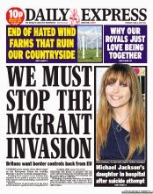
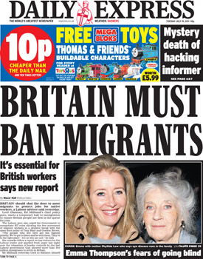
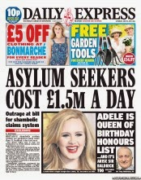
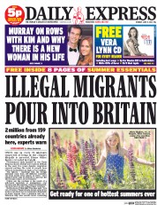
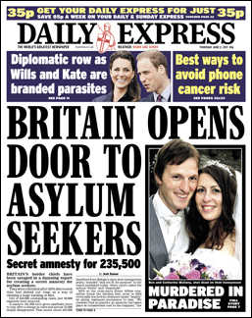
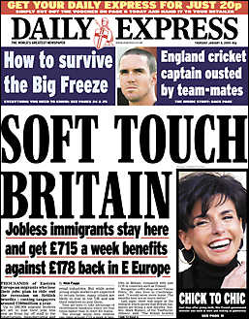
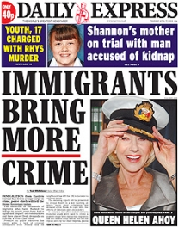
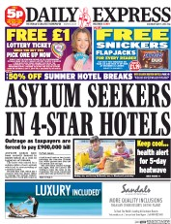


Slide 8
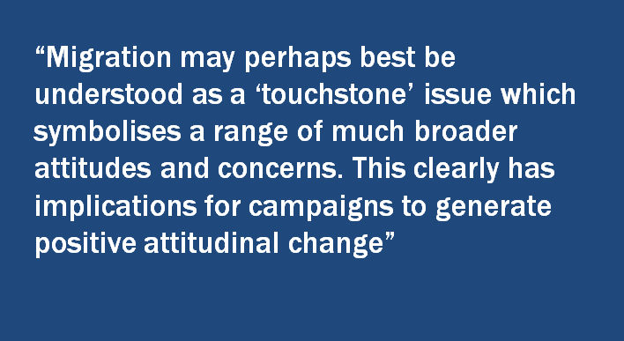

Slide 9
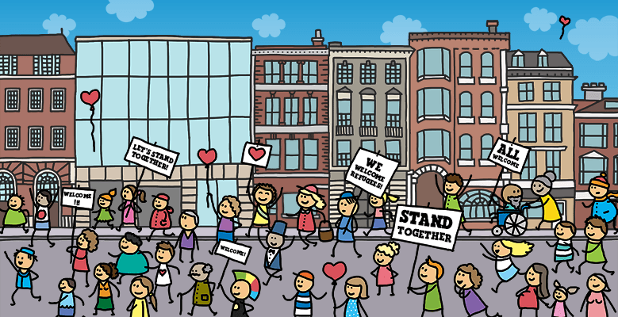
Moving beyond fear and hate

Slide 10
Political leadership is important but…
Need to amplify positive voices / attitudes in order to challenge dominant narratives and create new ones
What does that mean in practice?
  Increasing opportunities for civil society engagement , esp young people, migrants themselves
  Providing financial and other support for grassroots mobilisation
  Creating shared spaces, bringing in new voices
  These initiatives may not secure media or political support but they are slowly creating change from the bottom up

Slide 11


Slide 12
We need to BREATHE
Bring people together #moreincommon
Remember that this is not just about migration
Enable migrants to have a voice
Amplify the positives
Talk to people and build new partnerships
Harness technology to share information
Engage young people

Slide 13


For more information
and copies of the reports:
heaven.crawley@coventry.ac.uk
@heavencrawley

